Slide 1


YILDIZ TECHNICAL UNIVERSITY
MATHEMATICAL ENGINEERING DEPARTMENT
PROJECT FOR THE INTRODUCTION TO ARTIFICIAL
INTELLIGENCE (2026 SPRING)
HANOI TOWER
SOLUTIONS WITH AI SEARCH ALGORITHMS
Alperen İlhan İpçi
Bensu Kocatepe
Ezgi Nur Eren
Gökhan Keskin
Hamide Okumuş
Selma Cemal

Slide 2





CONTENTS
INTRODUCTION
PROBLEM DEFINITION
HEURISTIC AND ALGORITHM DESIGN
SIMULATION RESULTS AND PERFORMANCE ANALYSIS
www.reallygreatsite.com

Slide 3


1-INTRODUCTION
What is Hanoi Tower?
The Tower of Hanoi is a puzzle invented by French mathematician Édouard Lucas in 1883. The setup of the game is quite simple: there are 3 pegs standing side by side, and initially, a number of N disks are stacked on one of these pegs from largest to smallest (forming a conical shape).

Slide 4

The game has a single objective: to move all the disks from the starting peg to the target peg while adhering to 3 golden rules. These rules are as follows:
Only one disk can be moved at a time.
Only the top disk of a peg can be moved.
A larger disk can absolutely never be placed on top of a smaller disk.
www.reallygreatsite.com

Slide 5

Why Hanoi Tower is Classified as an Artificial Intelligence Search Problem?
What makes the Tower of Hanoi an Artificial Intelligence problem is that it cannot be solved with a single closed-form mathematical formula. The AI agent must autonomously find its path step-by-step within a rule-constrained state space. As the number of disks increases, the number of possible configurations grows exponentially according to the formula 3^N, a phenomenon known as a "combinatorial explosion." If the AI navigates blindly in this massive ocean of possibilities, it will inevitably get trapped in infinite loops; this is exactly why an intelligent search strategy is required to efficiently reach the goal.

Slide 6

Why Hanoi Tower is Classified as an Artificial Intelligence Search Problem?
The Tower of Hanoi is an ideal benchmark for evaluating AI search algorithms. Instead of relying on blind, brute-force exploration, our AI agent uses a heuristic function (h(n)) to dynamically evaluate moves. This informed approach allows the system to intelligently prune suboptimal branches, eliminate infinite loops, and efficiently find the shortest optimal path to the goal.

Slide 7

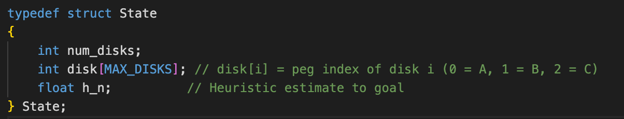
2-PROBLEM DEFINITION
-States-
How We Represented the Problem
We used a struct State to track the exact configuration of the puzzle at any moment.
disk[MAX_DISKS] array: Each index represents a disk, and its value (0, 1, or 2) tells the algorithm which peg that disk is currently on.
h_n: This stores the heuristic value (estimated distance to goal), which is critical for informed search algorithms like A*.

Slide 8
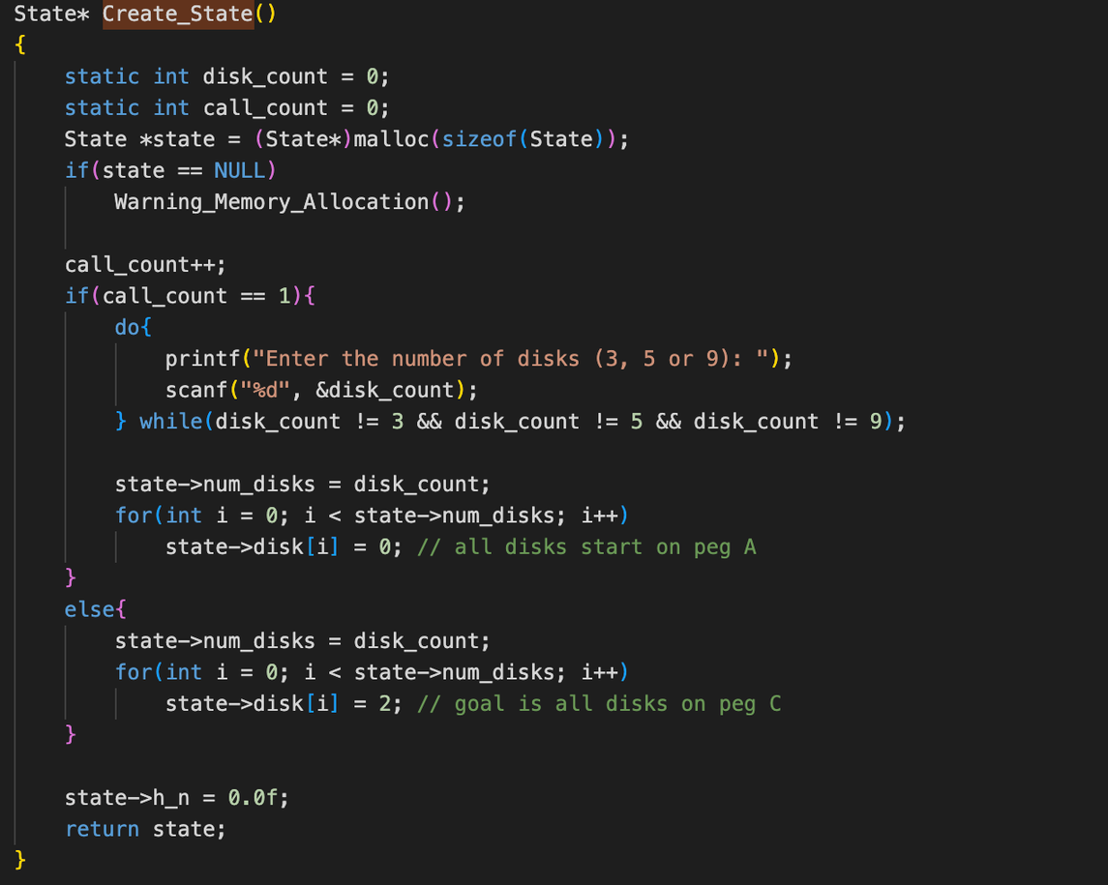
INITIAL STATE
www.reallygreatsite.com

Slide 9


In our state-space search, the initial state represents the environment's configuration before any AI actions occur. For a problem size of N disks (3, 5, or 9), all disks are initially stacked on the source peg (Peg A) in descending order of size, leaving Peg B and Peg C completely empty. Programmatically, this exact layout is mapped into the struct State variable, serving as the root node from which our algorithms begin their frontier expansion.
www.reallygreatsite.com

Slide 10

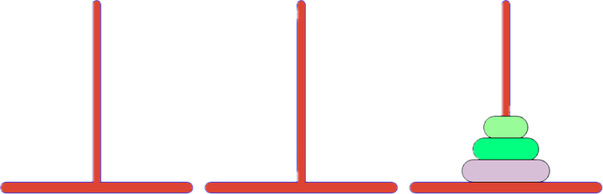
GOAL STATE
The goal state defines the specific terminal criteria that a state must satisfy for the search algorithm to stop and report a successful solution. In this project, the goal test logic continuously evaluates whether a newly generated node matches the objective configuration of the Hanoi Towers puzzle.

Slide 11
Formally, a state is classified as the target goal state if and only if it meets the following final criteria:
All N disks have been successfully transferred from the initial peg to the designated destination peg, Peg C
The disks on Peg C must perfectly replicate the original size hierarchy, stacked in descending order of their diameters from bottom to top.
Both the source peg, Peg A, and the auxiliary peg, Peg B , must be entirely empty.

Slide 12

The algorithm ends when the last disk on peg A moves to peg C; reaching the goal state where peg C is full and the other pegs are completely empty.

Slide 13

LEGAL ACTIONS AND CONSTRAINTS
Only the topmost, unobstructed disk of the source peg can be legally moved during a transition.
The agent is restricted to moving exactly one disk per state transition, meaning that the simultaneous movement of multiple disks is strictly prohibited.
A larger disk cannot be placed on top of a smaller disk; thus, the destination peg must either be completely vacant or host a topmost disk with a diameter strictly greater than the moving disk.
www.reallygreatsite.com

Slide 14
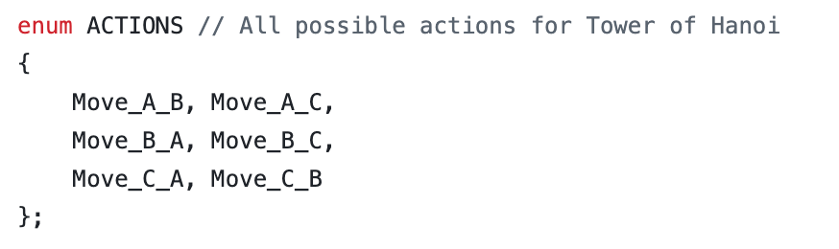
In a state-space search paradigm, an action is a valid operator that transitions the environment from a current state s to a successor state s'. For the Tower of Hanoi, an action is defined as relocating a single disk from a source peg to a destination peg.
www.reallygreatsite.com

Slide 15

TRANSITION MODEL
The Logic: Defines the rules for moving from a Parent State to a Successor State.
Validation Rules:
Checks if the source peg has disks.
Strictly prevents placing larger disks on top of smaller ones.
Returns false immediately if any constraint is violated.
State & Cost Update:
Saves the valid move into Transition_Model.new_state.
Adds a fixed +1.0 cost to the path cost (g(n)) for every single step.

Slide 16
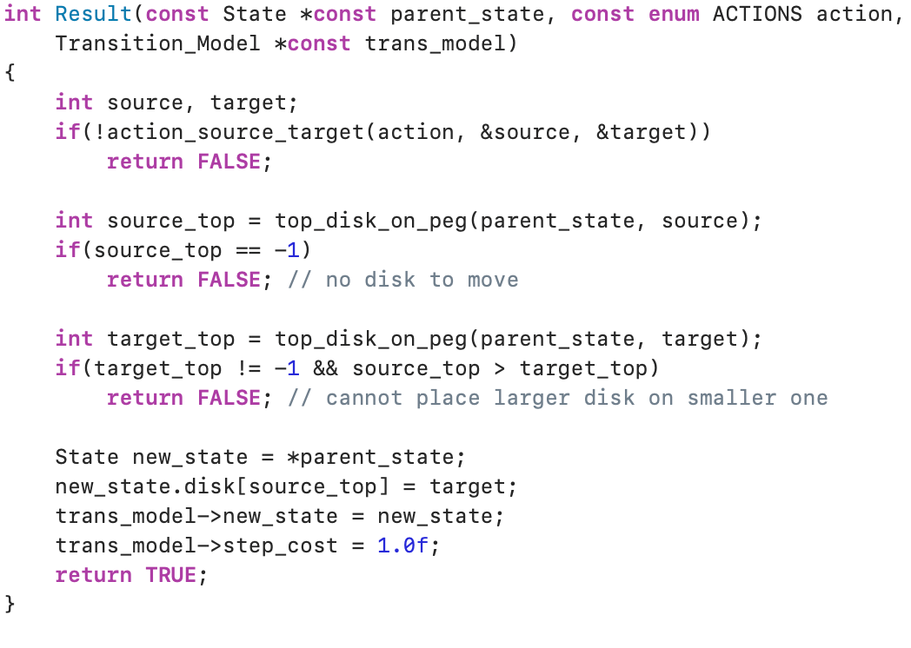
Transition Model Structure

Slide 17
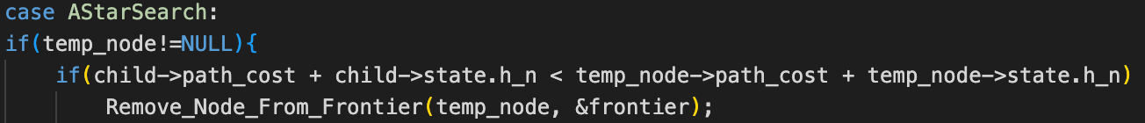
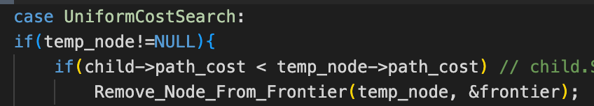
3-HEURISTIC AND ALGORITHM DESIGN
Implementation of the Generalized A*Search Algorithm
The Baseline (Uniform-Cost Search): Evaluates expanding nodes strictly based on the accumulated path cost g(n) (child->path_cost), searching blindly without direction.
The A Transformation:* Infuses the evaluation with a heuristic function h(n) (child->state.h_n), mathematically converting a blind search into a goal-directed optimization.
The Cost Function: Implemented via f(n) = g(n) + α * h(n) to dynamically balance path cost and heuristic weight, significantly reducing the generated nodes in memory.

Slide 18
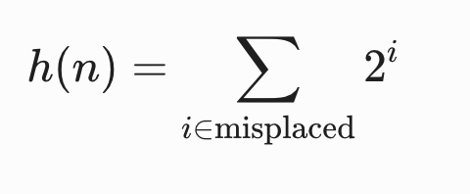
Heuristic Function (h(n)) Selection and Admissibility Analysis
The Core Logic (General Approach): * Simple approach: Just counting the number of misplaced disks.
The Problem: It ignores the sequential rules of the puzzle (e.g., small disks blocking larger ones).
Our Implementation (SpecificToProblem.c):
Uses a bitwise weight distribution to reflect real physical constraints.
Every misplaced disk i adds an exponential penalty of 2^i to the total cost.

Slide 19
Admissibility Analysis
The Golden Rule of A* (h(n) <=h*(n)):
A heuristic is strictly admissible if it never overestimates the actual remaining cost to reach the goal.
Admissibility guarantees that Generalized A* will always find the globally optimal path.
The Physical Proof (Structural Recursion):
To legally move any disk i to the destination peg:
All smaller disks (0 to i-1) must first be cleared and stacked on the auxiliary peg.
Why h(n) is "Optimistic":
This recursive bottleneck guarantees that the true minimum actions required (h*(n)) will always match or exceed our geometric calculation (2^i).
Since our code is mathematically optimistic, it never overestimates the real effort.
Conclusion: h(n) is strictly admissible --> The solution is globally optimal.

Slide 20
Code Architecture and Modified Source Files
Legacy Architecture: The original codebase was designed for geographic pathfinding, identifying states using simple city integer indices.
Adapting to Hanoi Towers: We restructured HashTable.c, specifically the Generate_HashTable_Key function, to capture the complex layout of multiple disks across pegs.
Dynamic Key Generation: A new loop iterates through state->num_disks, converting each disk's specific position into a character sequence to form a null-terminated string.
Cyclical Path Pruning: This guarantees a unique hash key for every disk permutation, allowing the explorer_set to accurately track visited states and prevent infinite loops during search.

Slide 21
4.SIMULATION RESULTS AND PERFORMANCE ANALYSIS

Slide 22
Quantitative Evaluation and Simulation Metrics Table
PROBLEM SIZE(NUMBER OF DISKS) | OPTIMAL PATH COST | SEARCHED NODES | GENERATED NODES | COMPUTATIONAL EXECUATION TIME (ms)
3 DISKS | 7 | 25 | 53 | ~ 0
5 DISKS | 31 | 233 | 617 | 22
9 DISKS | 511 | 19513 | 57257 | 516
Table 1: Results in Breadth First Search(BFS)

Slide 23
Quantitative Evaluation and Simulation Metrics Table
PROBLEM SIZE(NUMBER OF DISKS) | OPTIMAL PATH COST | SEARCHED NODES | GENERATED NODES | COMPUTATIONAL EXECUATION TIME (ms)
3 DISKS | alpha=0 →7 alpha=0 .5→7 alpha=1→7 alpha=5→7 | alpha=0 → 25 alpha=0.5→16 alpha=1→15 alpha=5→18 | alpha=0→ 71 alpha=0.5→45 alpha=1→42 alpha=5→51 | ~ 0
5 DISKS | alpha=0→31 alpha=0.5→31 alpha=1→31 alpha=5→31 | alpha=0→233 alpha=0.5→136 alpha=1→153 alpha=5→162 | alpha=0→695 alpha=0.5→405 alpha=1→456 alpha=5→483 | alpha=0→13,7 alpha=0.5→26 alpha=1→19 alpha=5→17,2
9 DISKS | alpha=0→511 alpha=0.5→511 alpha=1→511 alpha=5→511 | alpha=0→19513 alpha=0.5→10936 alpha=1→13077 alpha=5→13122 | alpha=0→58535 alpha=0.5→32805 alpha=1→39228 alpha=5→39363 | alpha=0→517 alpha=0.5→507,3
Table 2: Results in Generalized A* Search Algorithm

Slide 24
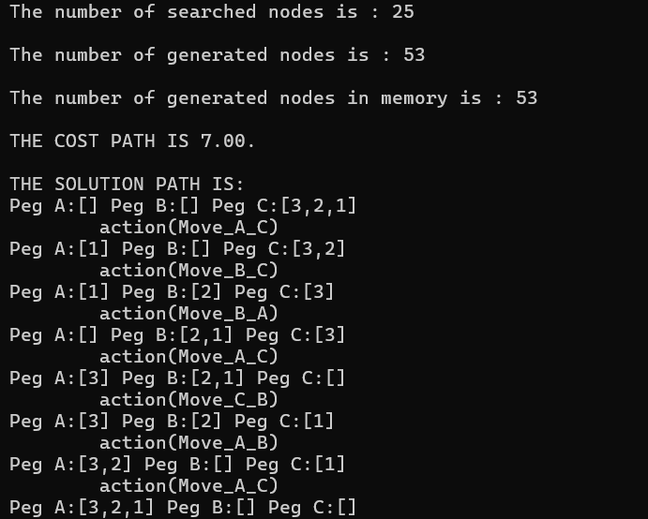
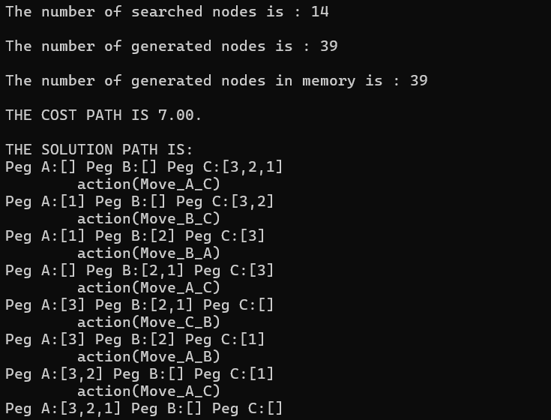
Experimental Verification via Terminal Outputs
3-Disk Problem Scale Execution
Breadth First Search for 3 disks
A* Search for 3 disks

Slide 25
Comparative Performance and State-Space Evaluation
The Problem: Exponential Growth
Execution time and node generation scale exponentially from 3 to 9 disks.
The Mathematical Gap: * State Space Growth: 3^N(Explores too many nodes)
Shortest Path:2^N - 1(Optimal target)
Consequence: Uninformed algorithms suffer from massive memory consumption.

Slide 26
The Solution: Hash Table & Graph Search
The environment is treated as a Graph instead of a Tree to prevent infinite loops.
Every unique state is transformed into a hashed key and stored.
The Optimization: Intelligent Pruning
Before any move, the transition model checks the Hash Table.
If the state already exists -->Branch is Pruning.
Keep the vast search process manageable and prevents cyclical loops.

Slide 27

CONCLUSION
The Problem with Blind Searches: Uninformed algorithms expand the search tree in all directions, causing exponential node growth, rapid memory exhaustion, and long execution times as disk count increases.
The Power of Heuristics: Generalized A* uses a heuristic function to estimate the distance to the target, prioritizing the most promising paths instead of checking every move equally.
Efficient Branch Pruning: By evaluating generated states early, it effectively prunes unnecessary branches from the transition model.
Optimal Performance: This results in minimized memory usage and faster execution, successfully reaching the goal without the bottlenecks seen in blind searches.
www.reallygreatsite.com

Slide 28

THANK YOU.

